Slide 1

ICE 3161
COMMUNICATION ENGINEERING
Dr. Asif Zaman
Professor, CSE, RU

Slide 2

Composite Signals
Pure sine wave:
The sine wave is carrying energy;
The sine wave is a signal of danger.
…1900s, the French mathematician Jean-Baptiste Fourier showed that:
Any composite signal is actually a combination of simple sine waves with different frequencies, amplitudes, and phases.

Slide 3
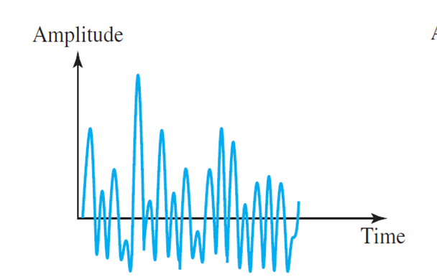
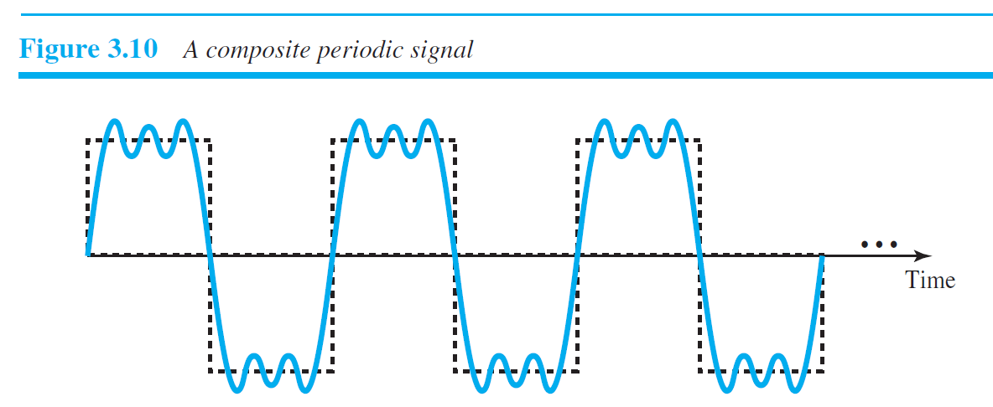
Composite Signals
If the composite signal is periodic: the decomposed signals are discrete freq.
Else (nonperiodic):
decomposed are sine waves with continuous freq.
It is very difficult to manually decompose this signal into a series of simple sine waves.
However, there are tools, both hardware and software, that can help us do the job.
We are not concerned about how it is done; we are only interested in the result.

Slide 4
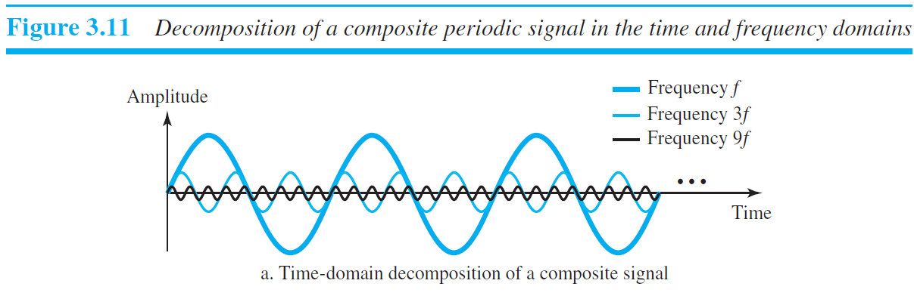
The frequency of the sine wave with frequency f is the same as the frequency of the composite signal; it is called the fundamental frequency, or first harmonic.
The lowest possible frequency
The sine wave with frequency 3f has a frequency of 3 times the fundamental frequency; it is called the third harmonic.
The third sine wave with frequency 9f has a frequency of 9 times the fundamental frequency; it is called the ninth harmonic.

Slide 5
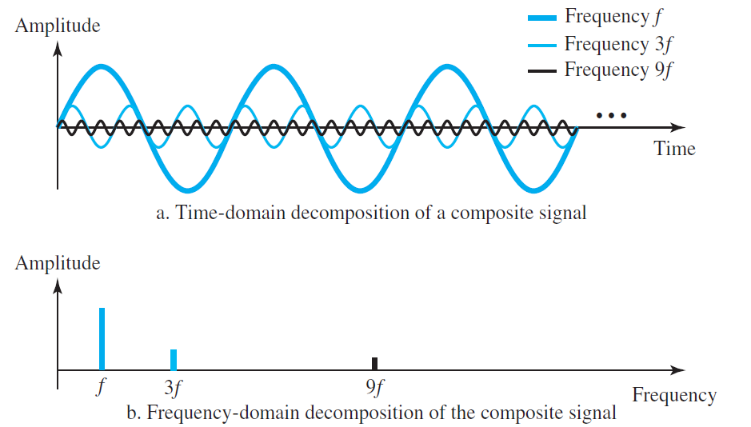
…the frequency decomposition of the signal is discrete; it has frequencies f, 3f, and 9f.
Because f is an integral number, 3f and 9f are also integral numbers.
There are no frequencies such as 1.2f or 2.6f.
The frequency domain of a periodic composite signal is always made of discrete spikes.

Slide 6

Composite Signals (Non-Periodic)

Slide 7
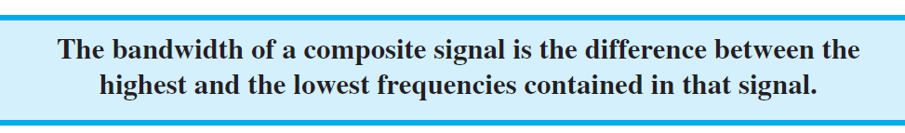
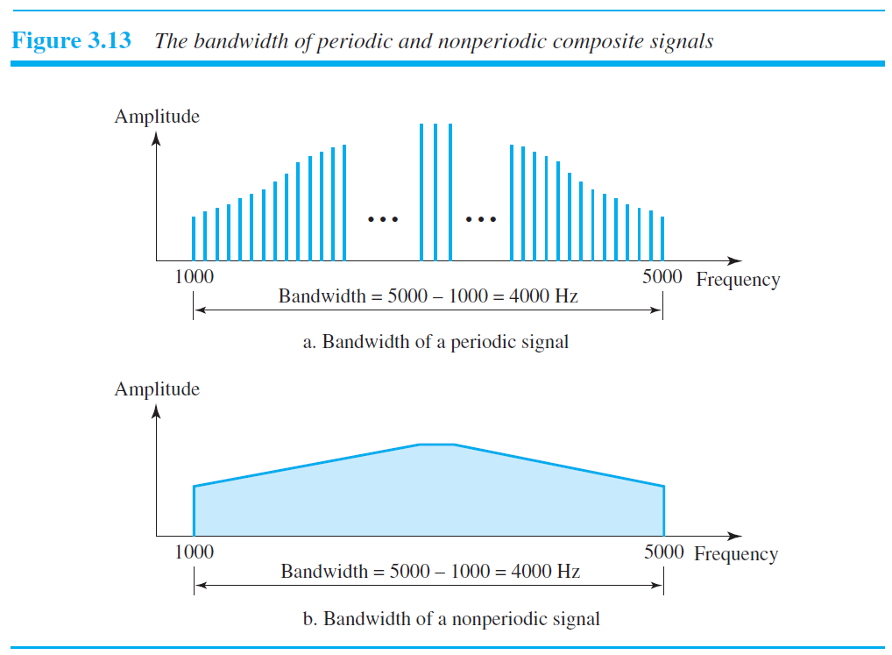
Bandwidth
The range of frequencies contained in a composite signal is its bandwidth.
The bandwidth is normally a difference between two numbers.
For example, if a composite signal contains frequencies between 1000 and 5000, its bandwidth is 5000 − 1000, or 4000.

Slide 8
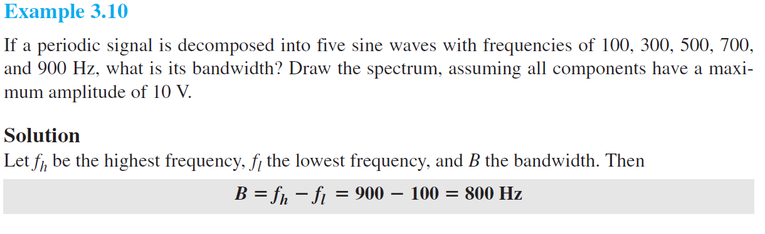
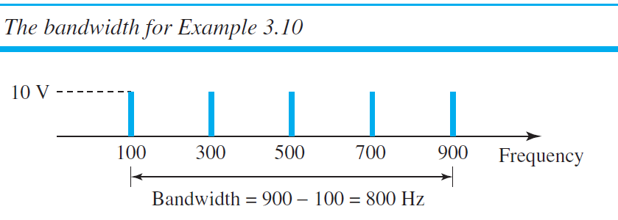
Bandwidth

Slide 9
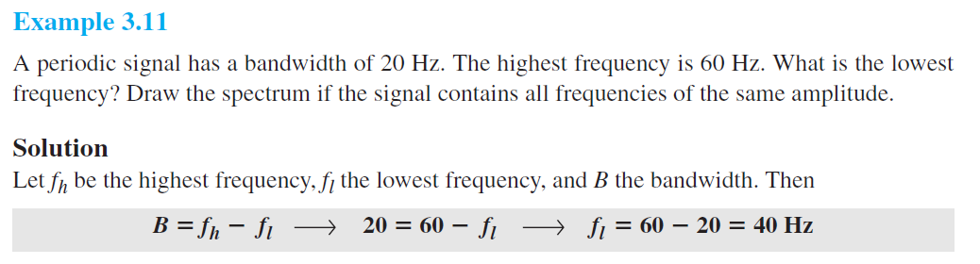
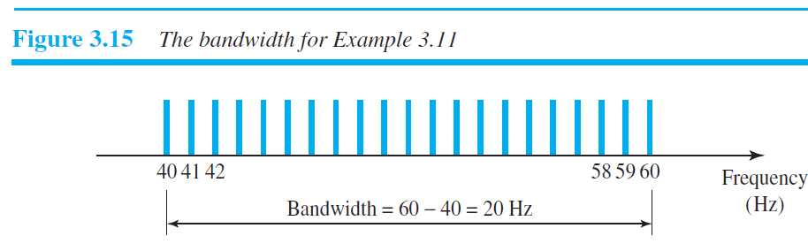

Slide 10
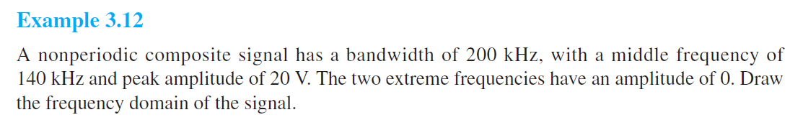
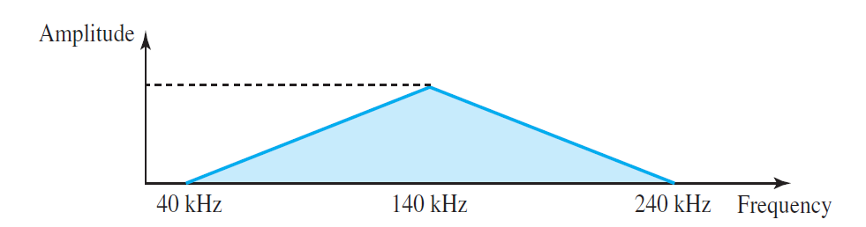

Slide 11
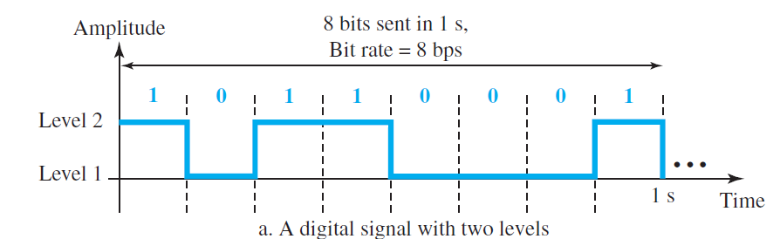
Digital Signals
information can also be represented by a digital signal.
A 1 can be encoded as a positive voltage and a 0 as zero voltage.
A digital signal can have more than two levels

Slide 12
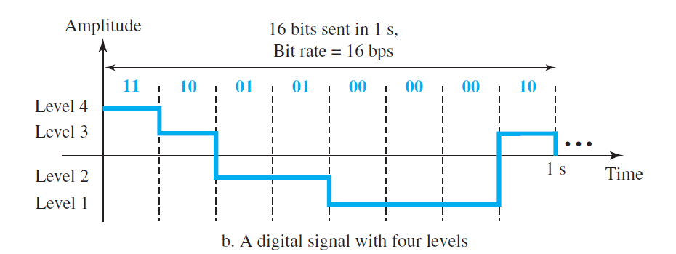
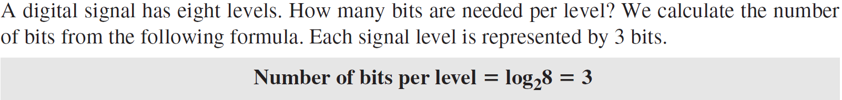
Digital Signals
In general, if a signal has L levels, each level needs
log₂L bits. For this reason, we can send log₂4 = 2 bits in part

Slide 13
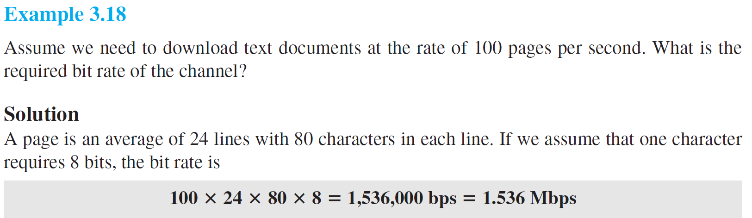
Bit Rate
The bit rate is the number of bits sent in 1s, expressed in bits per second (bps)
bit rate (instead of frequency)—is used to describe digital signals.

Slide 14
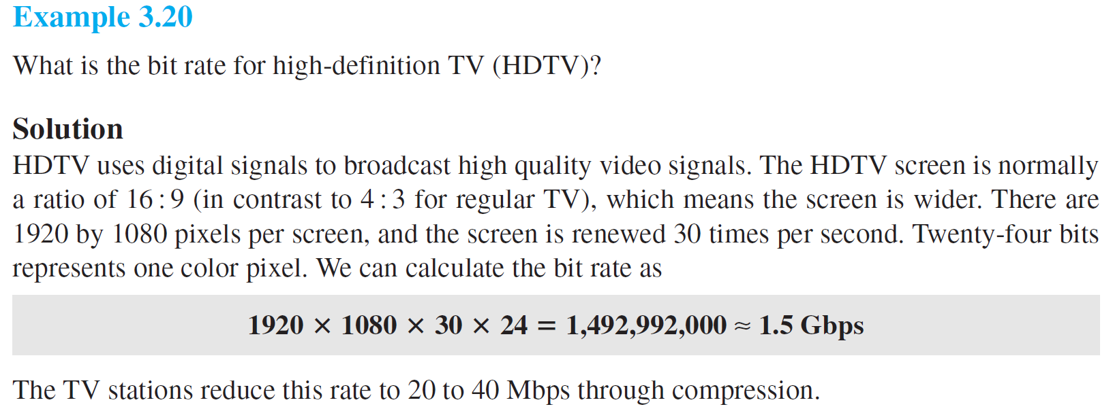
Bit Rate

Slide 15
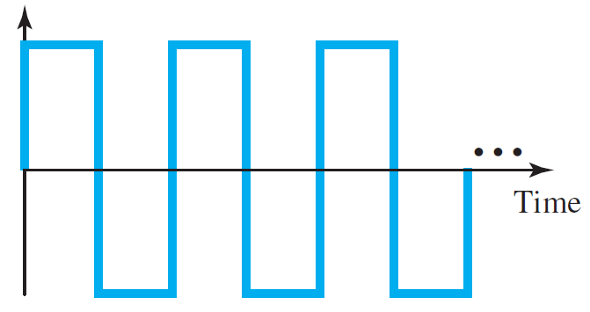
Digital Signal as a Composite Analog Signal
A digital signal is a composite analog signal.
The bandwidth is infinite.
A digital signal, in the time domain, comprises connected vertical and horizontal line segments
A vertical line in the time domain means a frequency of infinity (sudden change in time);
A horizontal line in the time domain means a frequency of zero (no change in time).
Going from a frequency of zero to a frequency of infinity (and vice versa) implies all frequencies in between are part of the domain.

Slide 16
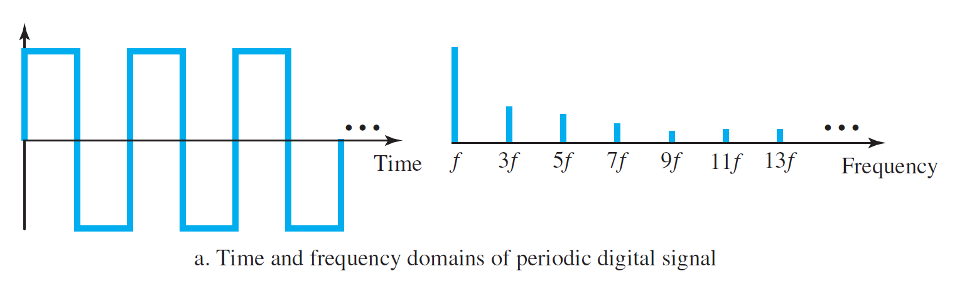
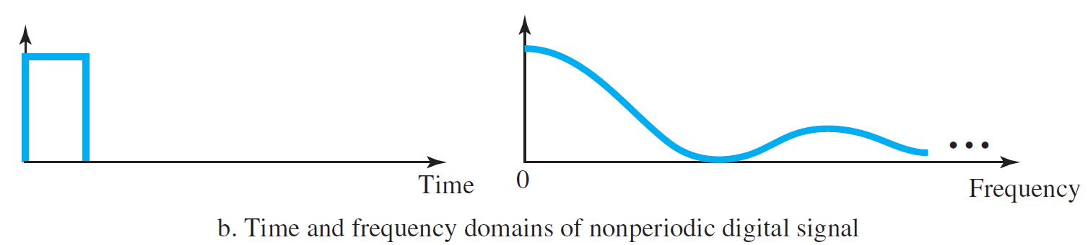
If the digital signal is periodic, which is rare in data communications, the decomposed signal has a frequency domain representation with an infinite bandwidth and discrete frequencies
If the digital signal is non-periodic, the decomposed signal still has an infinite bandwidth, but the frequencies are continuous.

Slide 17
Transmission of Digital Signals
The fundamental question is, How can we send a digital signal from point A to point B?
…a digital signal by using one of two different approaches:
baseband transmission or
broadband transmission

Slide 18
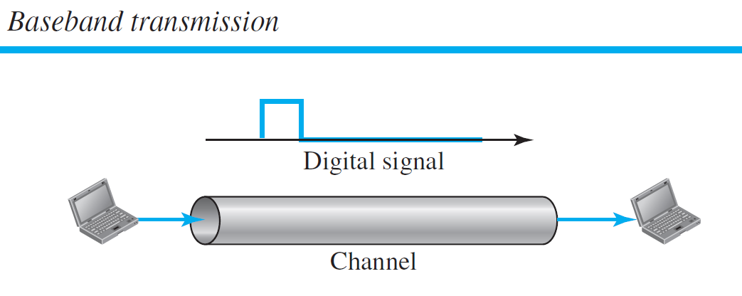
Transmission of Digital Signals
Baseband Transmission
Baseband transmission means sending a digital signal over a channel without changing the digital signal to an analog signal.

Slide 19
Baseband transmission requires :
we have a low-pass channel, a channel with a bandwidth that starts from zero.
This is the case if we have a dedicated medium with a bandwidth constituting only one channel.
For example, the entire bandwidth of a cable connecting two computers is one single channel.
As another example, we may connect several computers to a bus, but not allow more than two stations to communicate at a time.

Slide 20
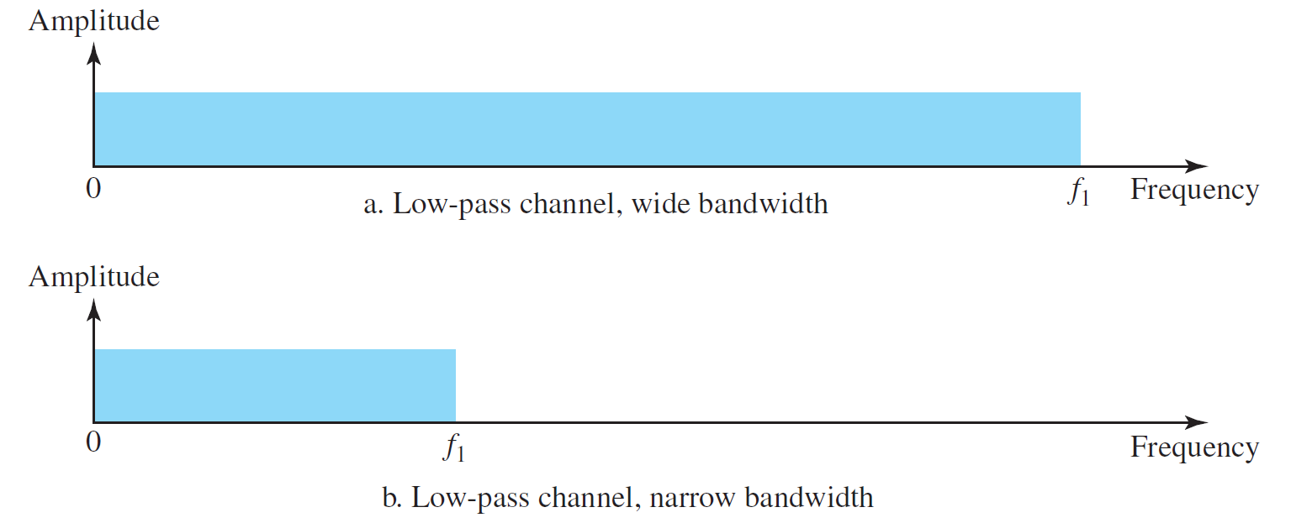
Case 1: Low-Pass Channel with Wide Bandwidth
Case 2: Low-Pass Channel with Limited Bandwidth

Slide 21
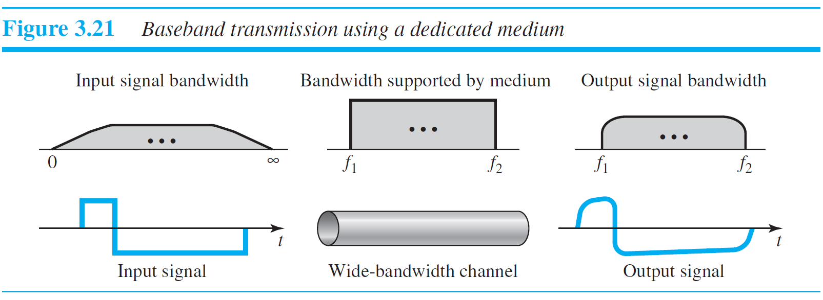
Case 1: Low-Pass Channel with Wide Bandwidth
Note that
f1 is close to zero, and
f2 is very high

Slide 22
Case 2: Low-Pass Channel with Limited Bandwidth
A low-pass channel with limited bandwidth, we approximate the digital signal with an analog signal.
The level of approximation depends on the bandwidth available.
Let us assume that we have a digital signal of bit rate N.
…the worst case, a maximum number of changes in the digital signal.
sequence 01010101 . . . or
the sequence 10101010. . . .

Slide 23
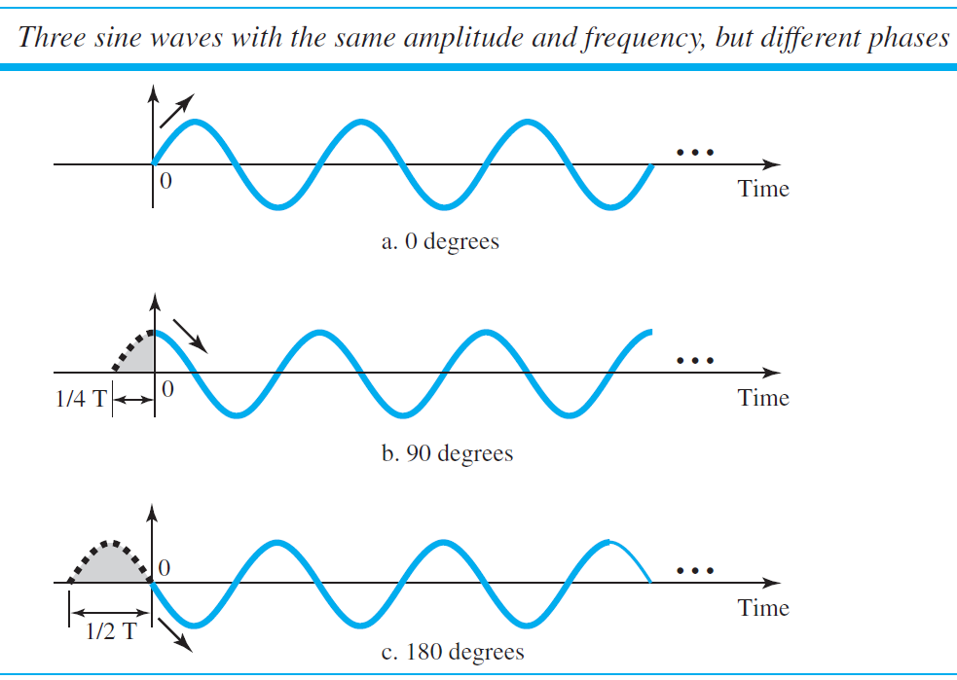
Case 2: Low-Pass Channel with Limited Bandwidth
We need an analog signal of frequency f = N/2.
Let,
1 be the positive peak value and
0 be the negative peak value.
We send 2 bits in each cycle; the frequency of the analog signal is one-half of the bit rate, or N/2.
Just this one frequency cannot make all patterns; we need more components.

Slide 24
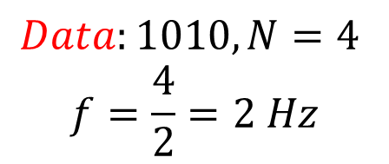

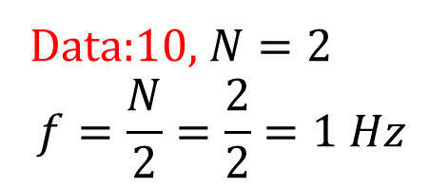
Data:10, $N=2$
$$f=\frac{N}{2}=\frac{2}{2}=1 Hz$$
$$Data:1010, N=4$$
$$f=\frac{4}{2}=2 Hz$$
the frequency of the analog signal is one-half of the bit rate, or $N/2$

Slide 25
Case 2: Low-Pass Channel with Limited Bandwidth
Just this one frequency cannot make all patterns; we need more components.
The maximum frequency is N/2.
let us see how a digital signal with a 3-bit pattern can be simulated by using analog signals

Slide 26
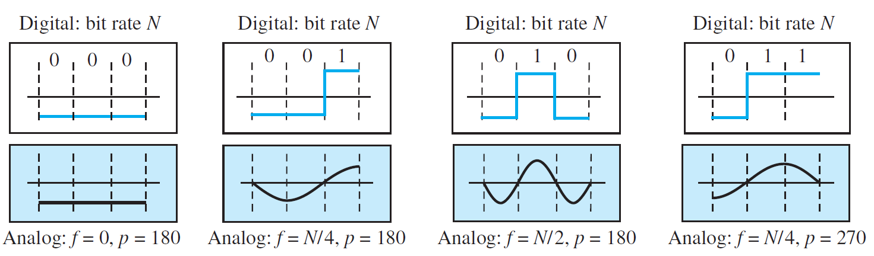
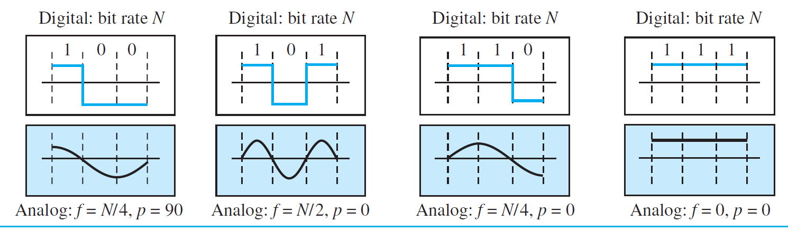

$$N=3$$

Slide 27
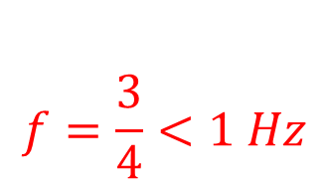
$$f=\frac{3}{4}<1 Hz$$
$$N=3$$

Slide 28
$$N=3$$

Slide 29
$$N=3$$

Slide 30
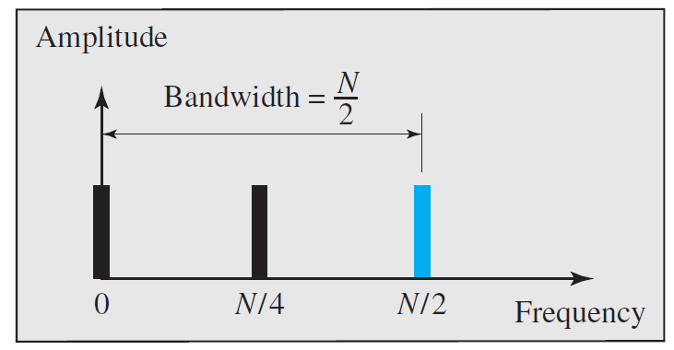

Slide 31
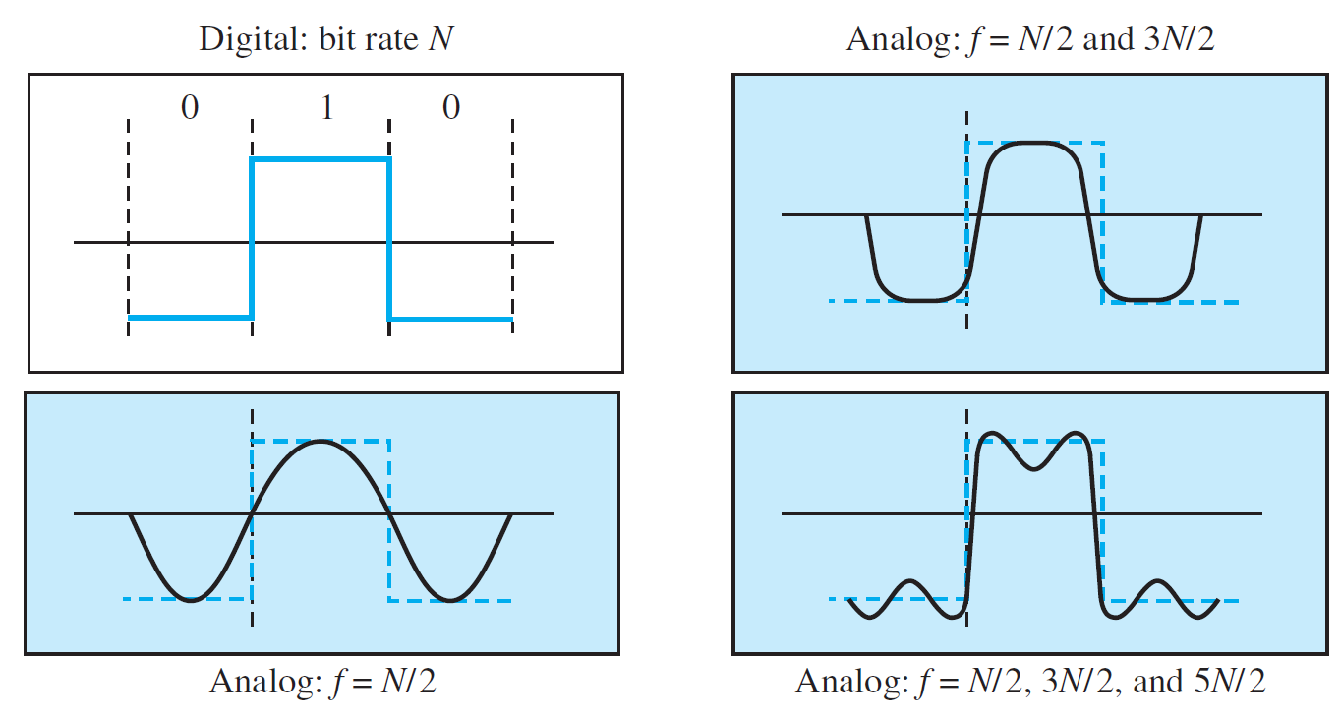
Better Wave

Slide 32
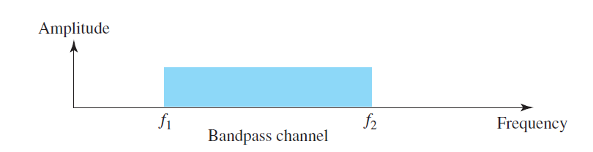
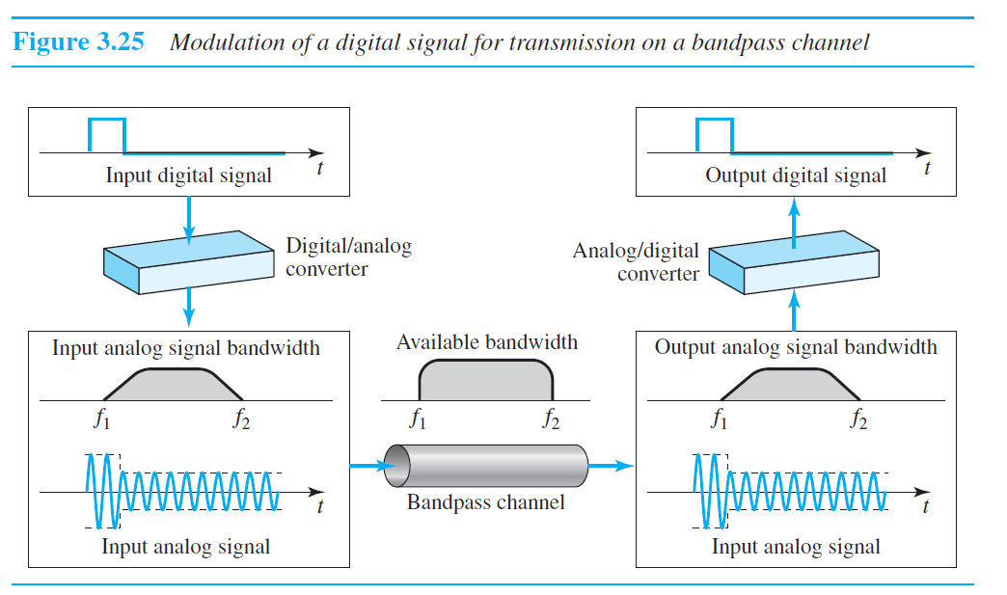
Broadband Transmission (Using Modulation)

